Slide 2
Reference link
https://www.dj4e.com/tools/crud/02spec.php?assn=02cats.php&PHPSESSID=e48dfb03d88fc4265fe44689d186cd8b

Slide 3

Create project

Slide 4
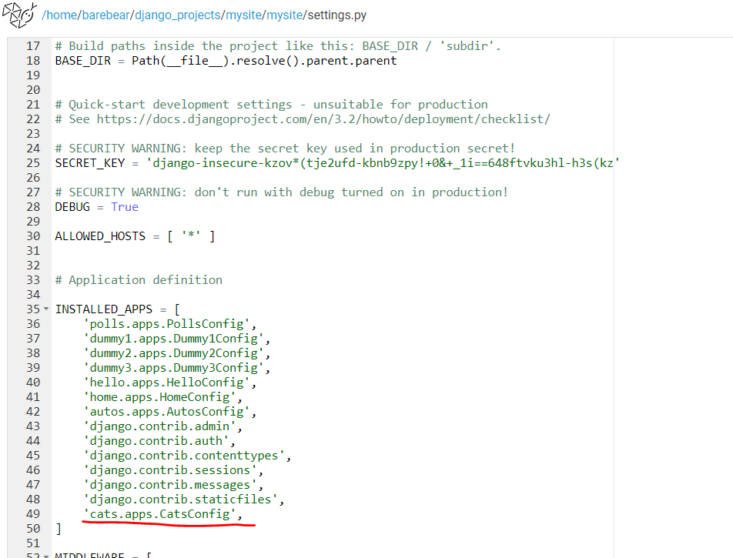
Edit settings.py

Slide 5
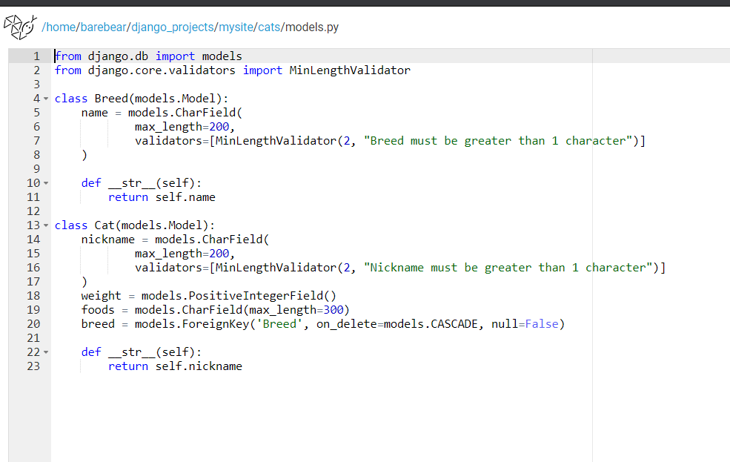
Update models.py

Slide 6
Perfomre migrations
Create database

Slide 7
Python mange.py makemigrations cats
Python mnage.py migrate
Notes:
Makemigrations: commits all the changes related to database
Migrate: create database files

Slide 8
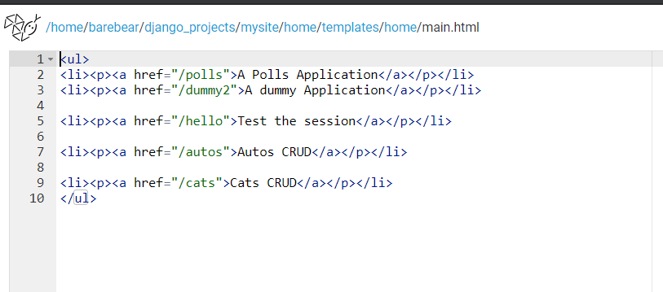
Update main.html

Slide 9
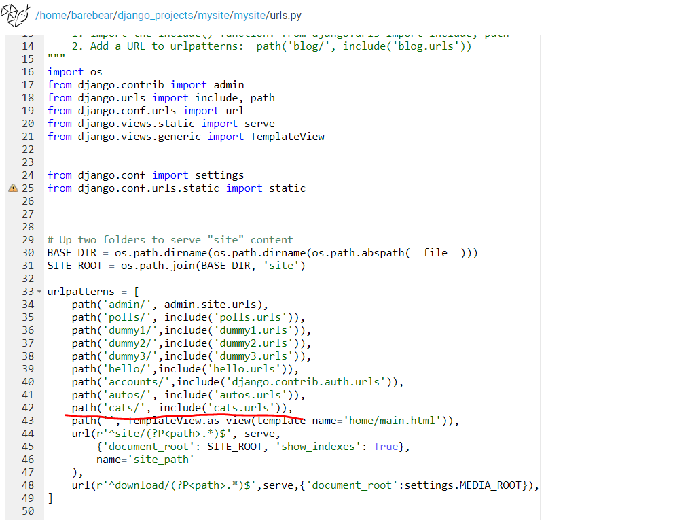
Update mysite/mysite/urls.py

Slide 10
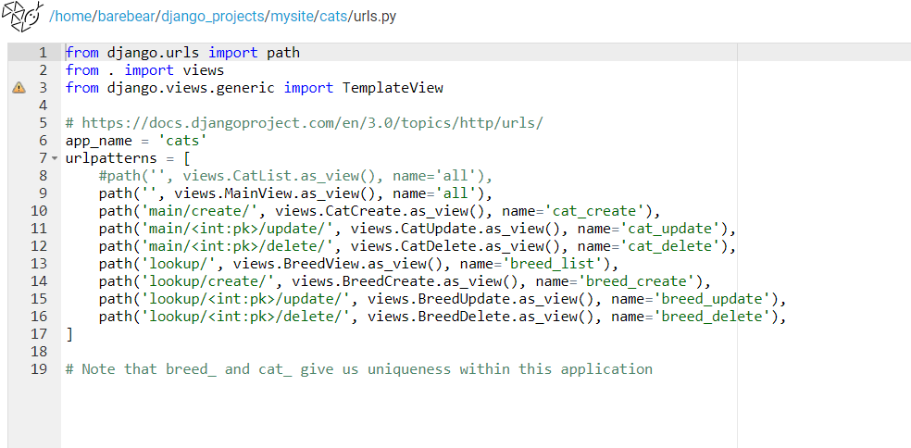
Update cats/urls.py
Notes:
add routes for the list, edit, and delete pages for both cats and breeds.

Slide 11
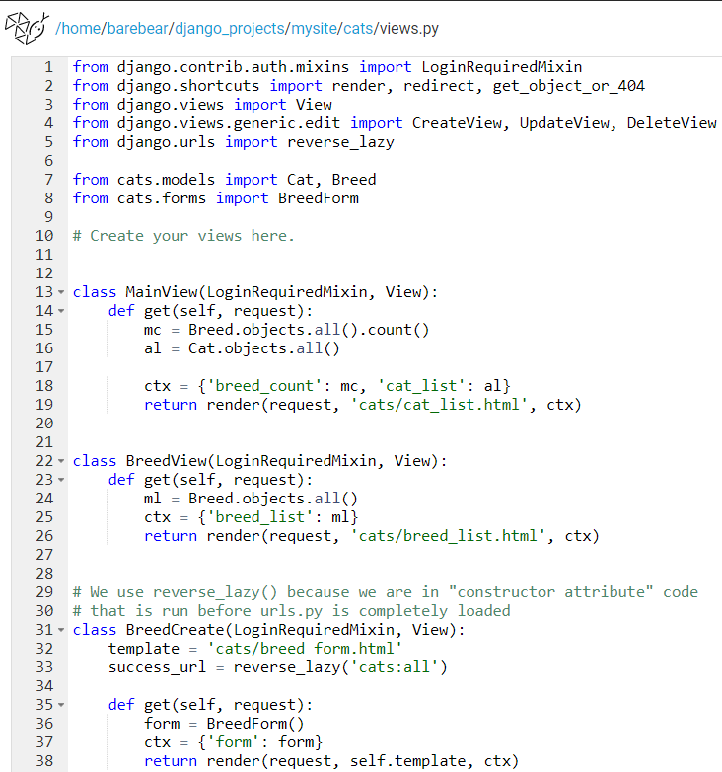
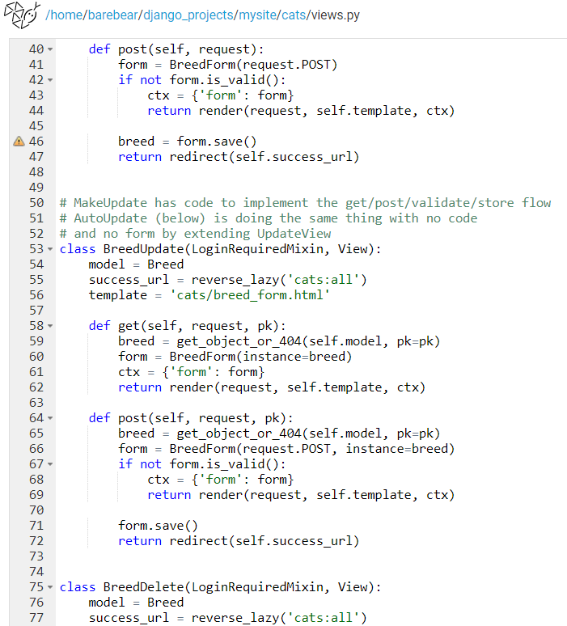
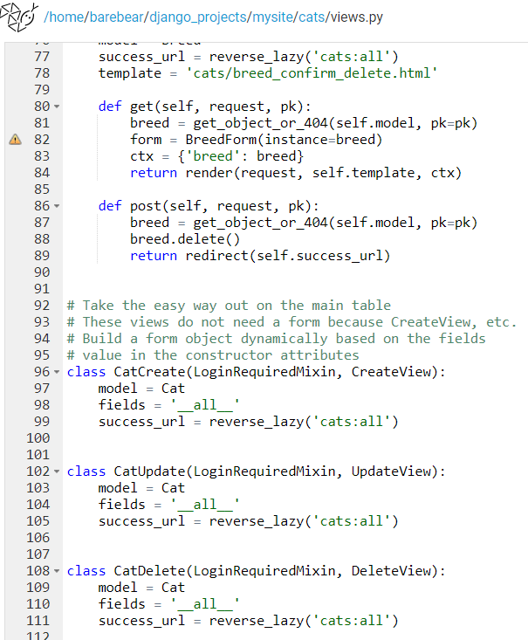
cats/views.py file to add/edit views for the list, edit, and delete pages for both cats and breeds.

Slide 12
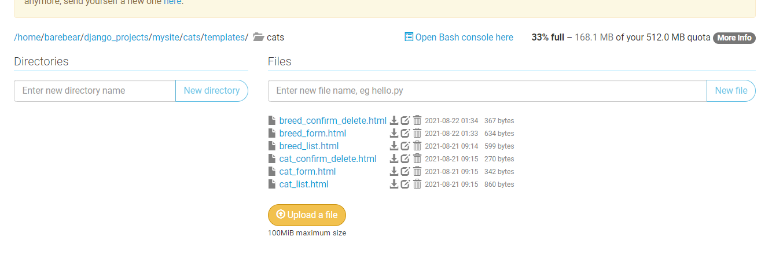
Create html file under template

Slide 13
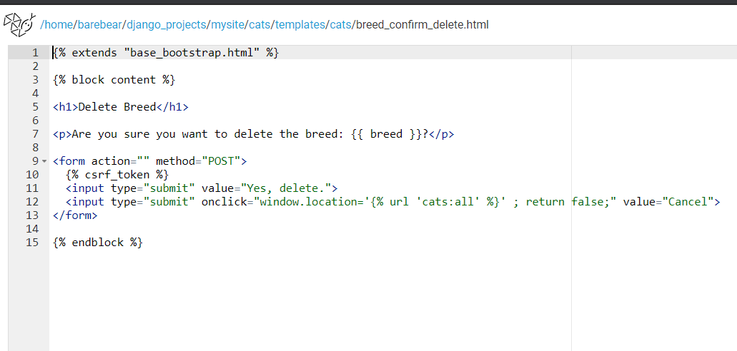
Breed_confirm-delete.html

Slide 14
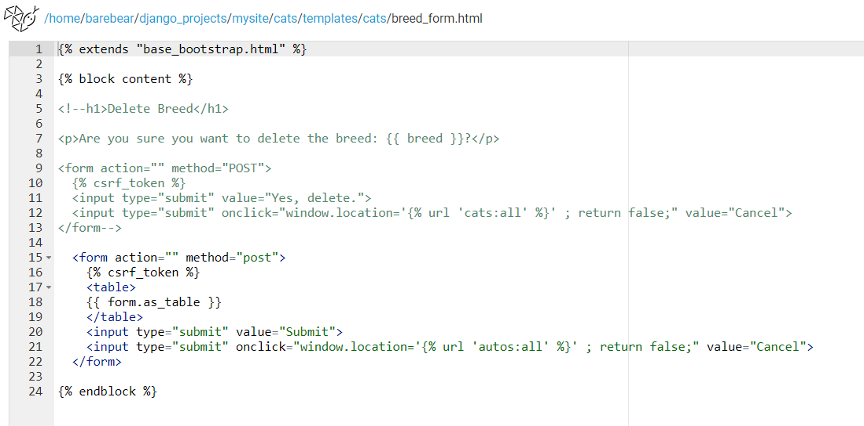
Breed_form.html

Slide 15
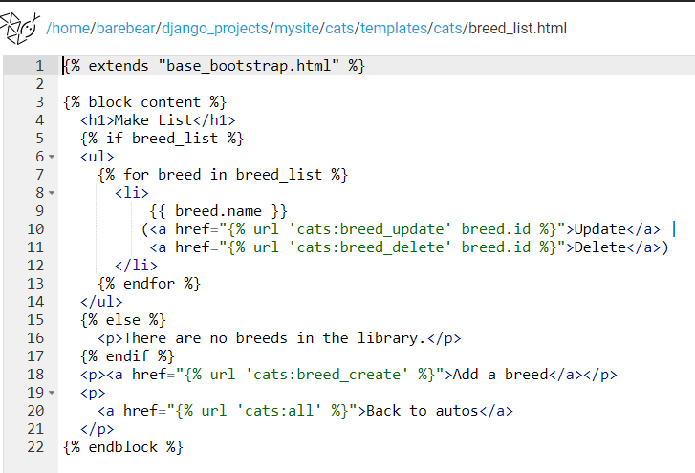
Breed_list

Slide 16
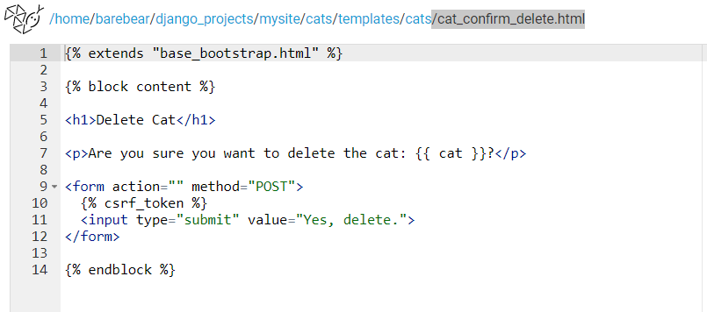
Cat_confirm_delete.html

Slide 17
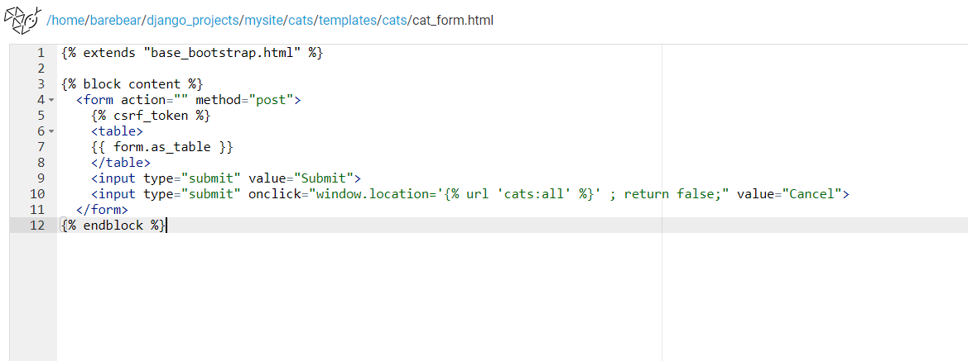
Cat_form.html

Slide 18
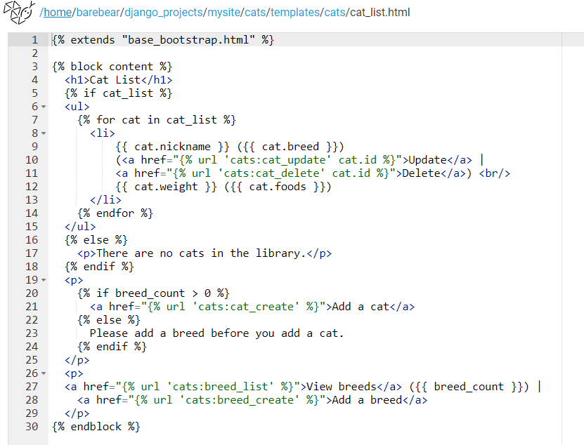
Cat_list.html

Slide 19
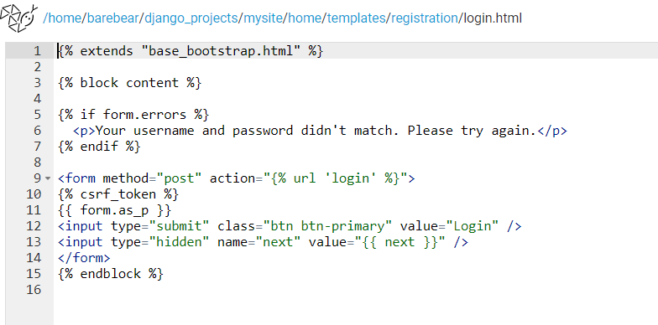
Login page

Slide 20
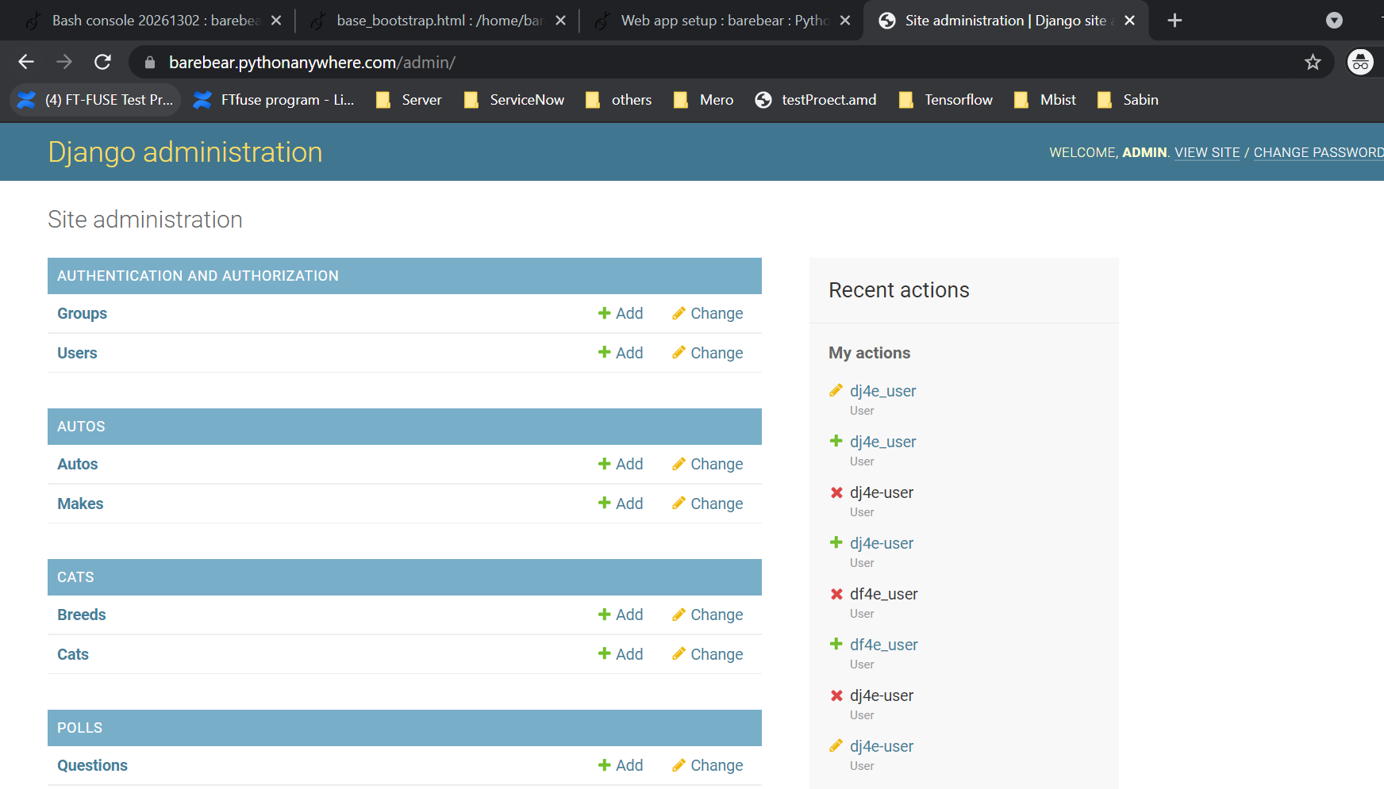
Create user name and password

Slide 21
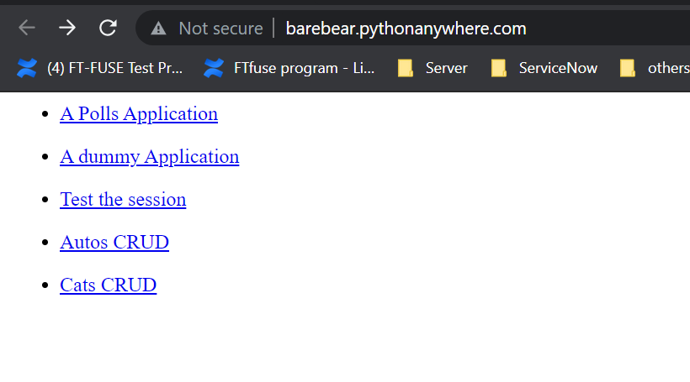
Username and password created in slide 20 will be used for login “Cats CRUD”

